Slide 1
Using Rivanna From the Command Line
Ahmad Sheikhzada & Gladys Andino
UVA Research Computing

Slide 2
Outline
UNIX
Rivanna
Terminal emulation/logging in
OOD
MobaXterm – PC (ssh, shell, SFTP)
Terminal/SSH - Mac
Basic Unix commands
Directories and files
File editing
File transfer
File transfer tool
Modules -How to load modules
Slurm
Practical

Slide 3
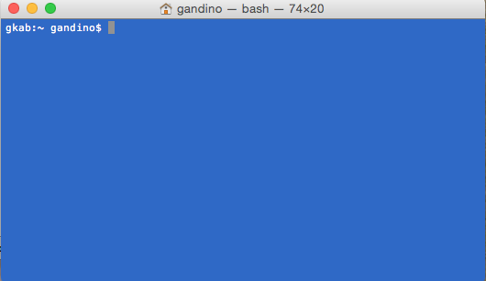
Overview - Unix
UNIX: is a text oriented operating system originally developed at Bell Labs during 1960s.
Linux is a version of Unix and is the dominate operating system used at high performance computing facilities. Linux powers most of the servers powering the internet, the majority of financial trades worldwide and a billion Android devices. In short, Linux is everywhere.
Unix is also underlying the Mac OSX graphical operating system.
You interact with the computer via a shell.
Navigation
Manipulation of files and directories
Editing files
Examining files
File transfer
Notes:
and has been under constant development ever since. By operating system, we mean the suite of programs which make the computer work.

Slide 4
Overview - The Shell
You interact with the Unix via a shell.
The shell is a program that interprets commands and acts as an intermediary between the user and the inner workings of the operating system.
There are several shells available. In most newer systems the default is bash (Bourne again shell). MacOS has switched recently to zsh.
You will have a prompt which indicates that the shell is ready to accept commands. It may appear as a $ or a directory name, or other symbols.
On Rivanna the default is -bash-4.2$

Slide 5
Overview - The Shell
To find out your shell, at the prompt type echo $shell
Unix in general and the shell in particular is case-sensitive.
The syntax of commands is not completely standardized but in general is
cmd -o --options <filename>
The pattern is a two or three-letter abbreviation, single-letter options preceded by one hyphen, multiple-letter options with two hyphens, and arguments at the end.

Slide 6



Overview – Supercomputer
Rivanna
Rivanna is the university's primary resource for high-performance computation. It provides a platform for computationally-intensive research across disciplines.

Slide 7
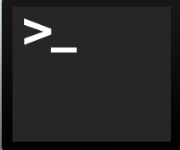
LOGGING IN
Logging into a remote UNIX based system requires a client. The options for client depends on your OS.
Command line access is based on the “SSH” or Secure Shell protocol
Encrypted
Used on most UNIX systems
Notes:
But once the connection is secure, everything is secure. Once you have an encrypted channel, nothing from that point on is sent outside that channel. Furthermore, the protocol is extremely cautious to avoid sending any sensitive data before encryption is available.

Slide 8
Logging in - using (OOD)
https://rivanna-portal.hpc.virginia.edu/
OpenOnDemand is a graphical user interface that allows access to Rivanna via a web browser. You can examine and manipulate files and submit jobs.
It is very easy and intuitive but, is limited. It's a good way to get started.
OOD also provides portals to applications such as Jupyterlab and R Studio Server.
When you first log in (through Netbadge) you will see the Dashboard.

Slide 9
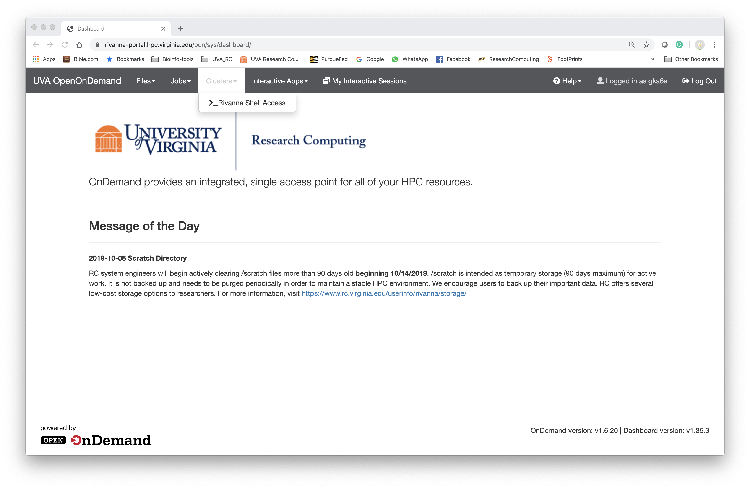
From the Dashboard go to Clusters > Rivanna Shell Access

Slide 10
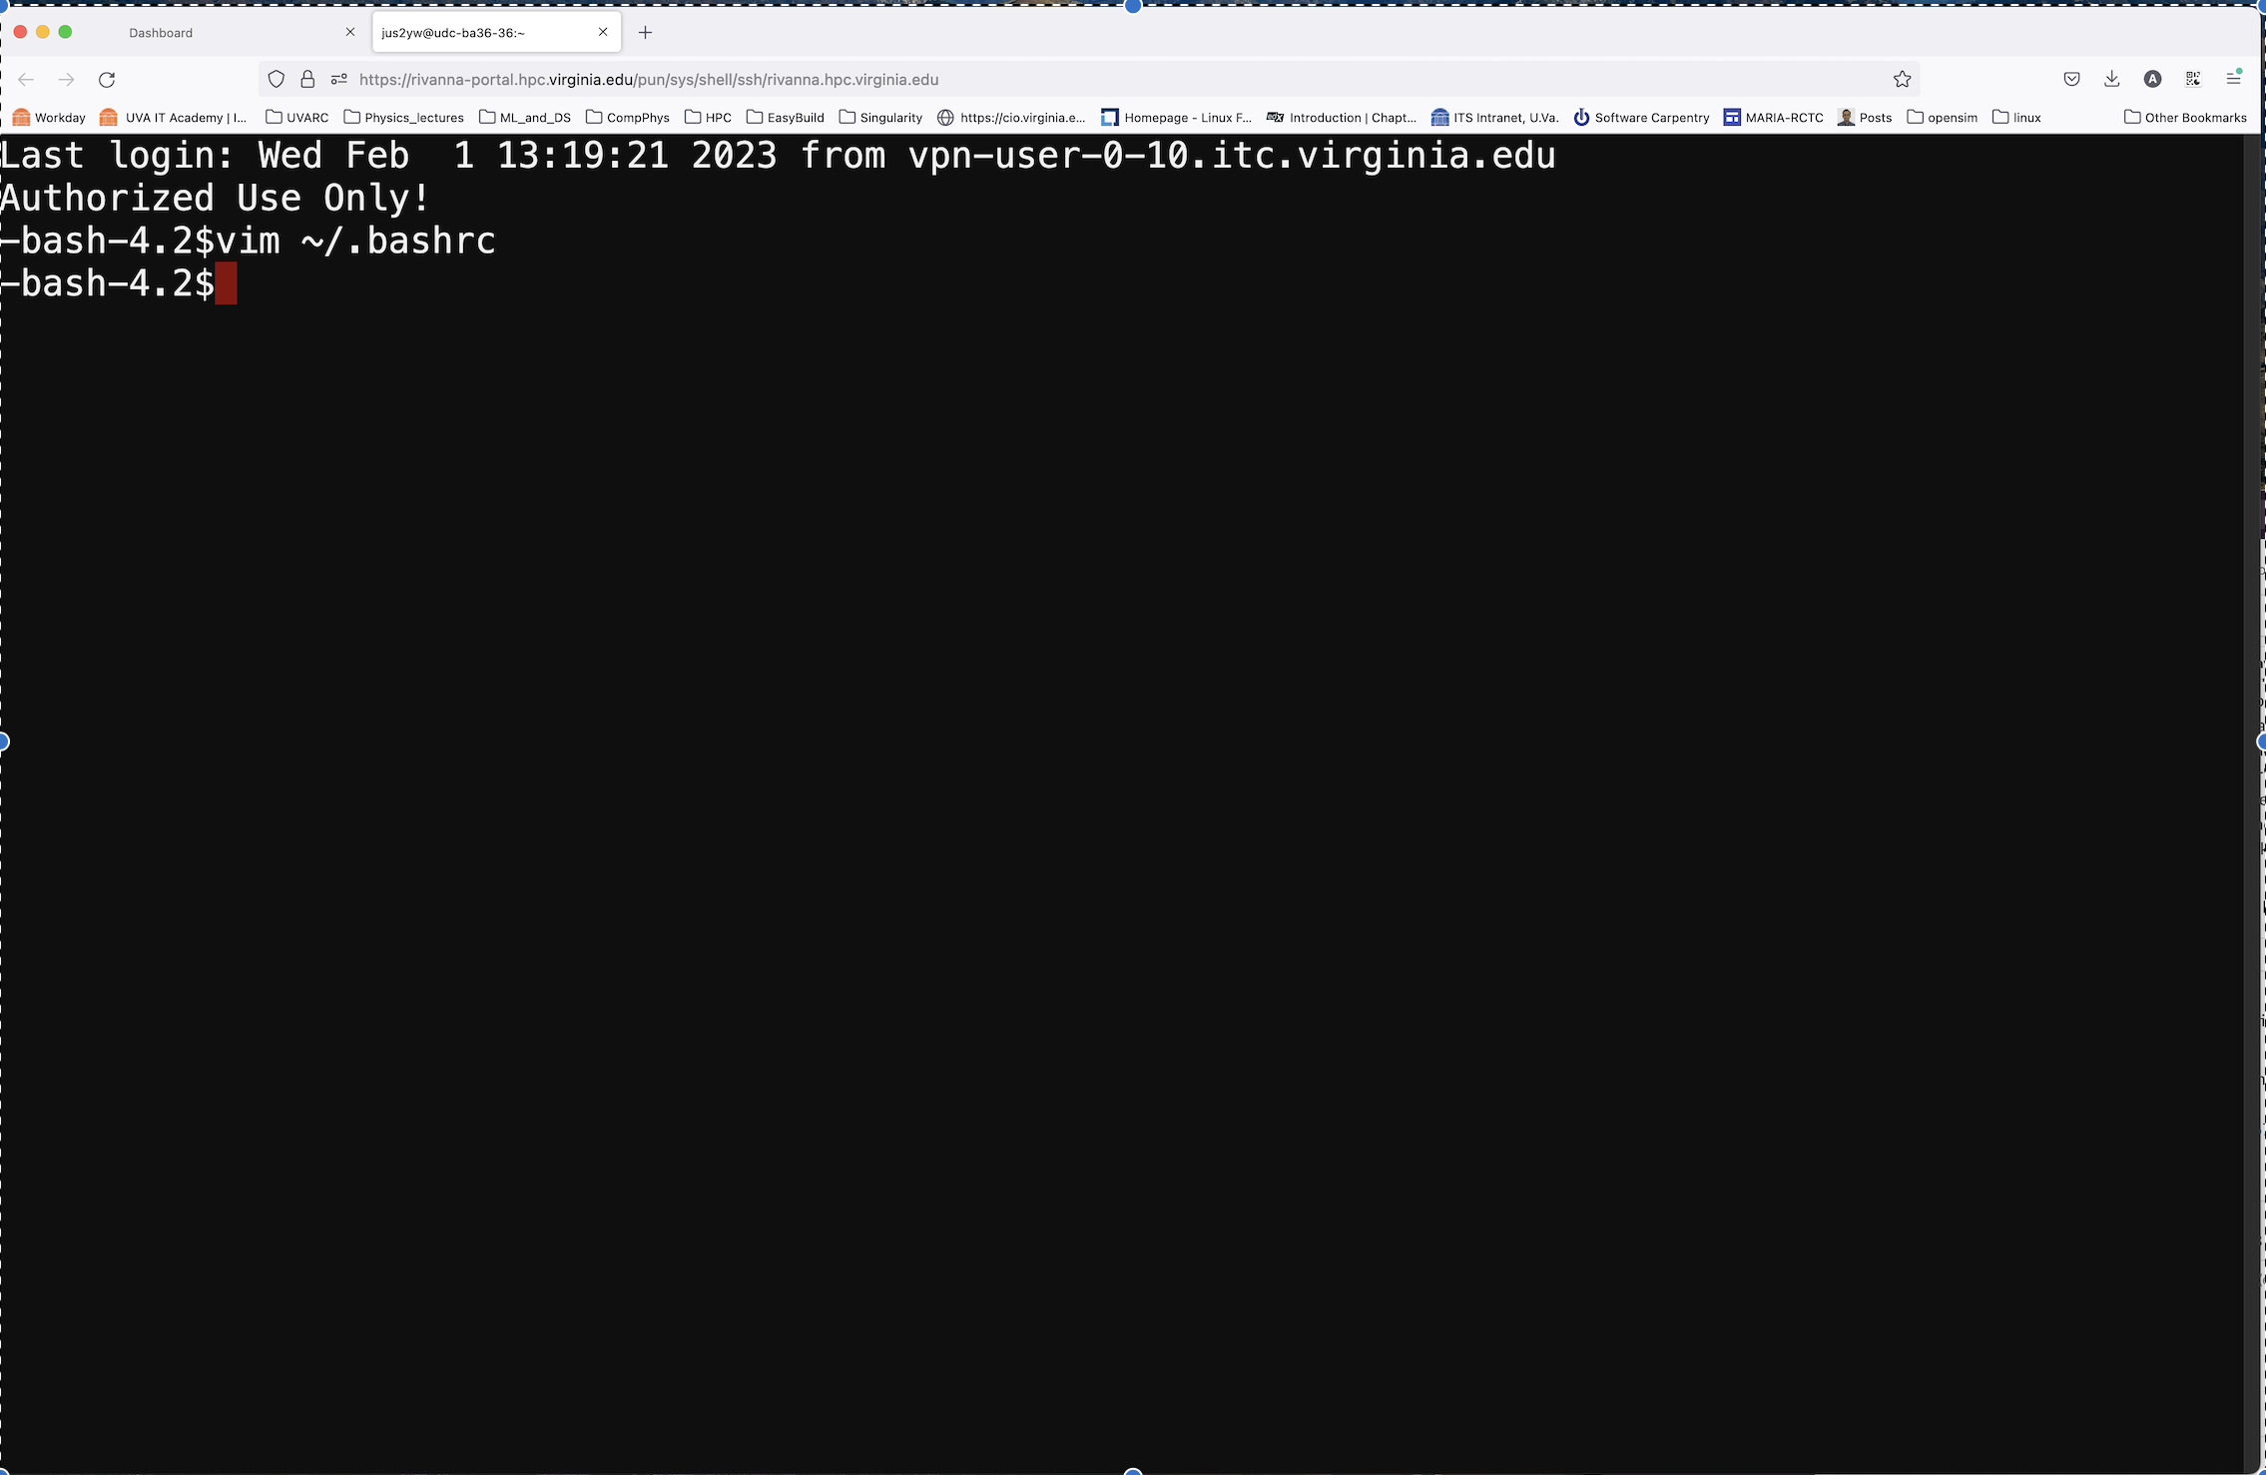

Slide 11
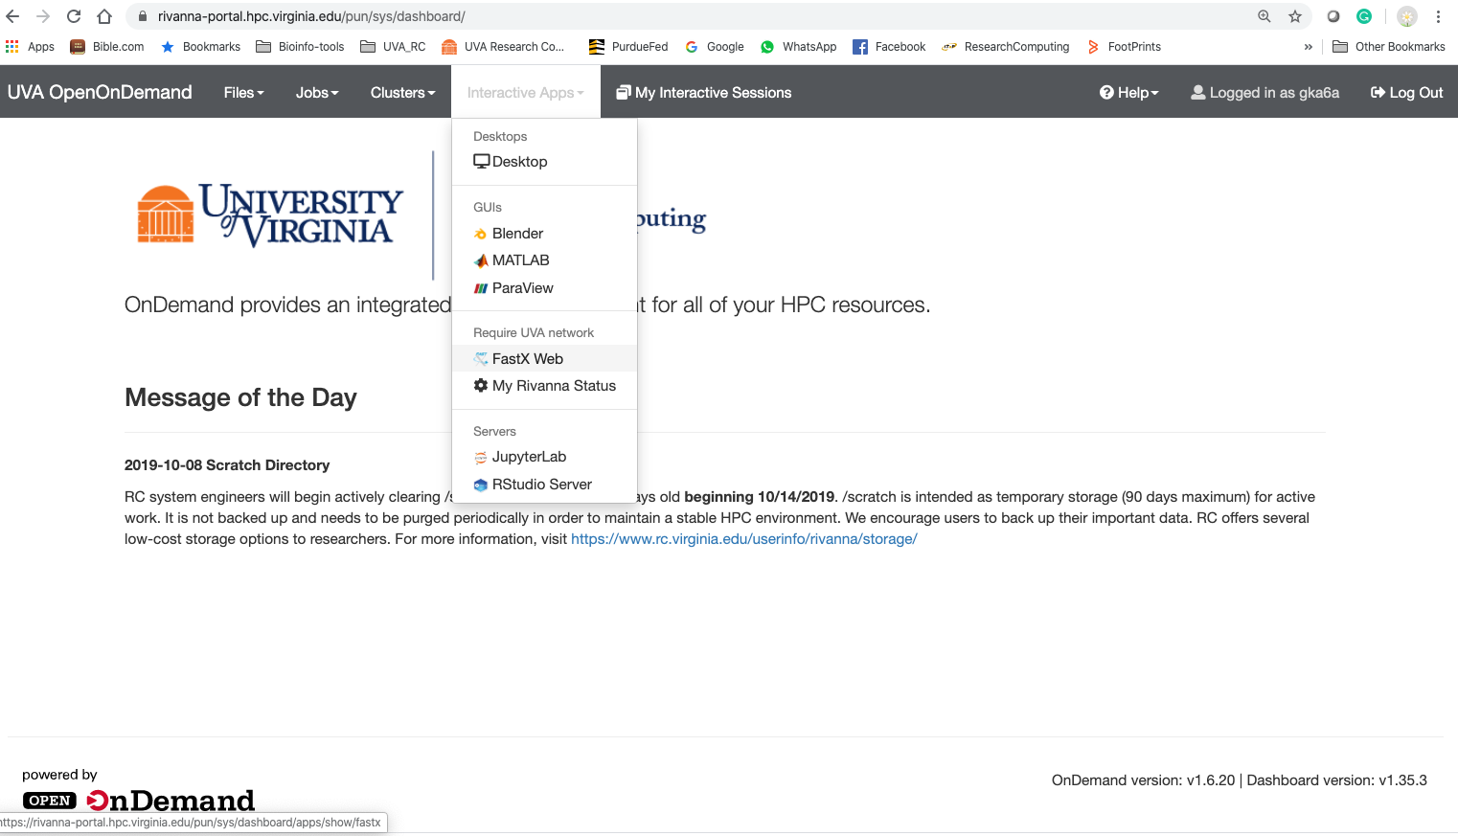
Logging in - using (FastX)
From the Dashboard go to Interactive Apps > FastX web
https://rivanna-desktop.hpc.virginia.edu/

Slide 12
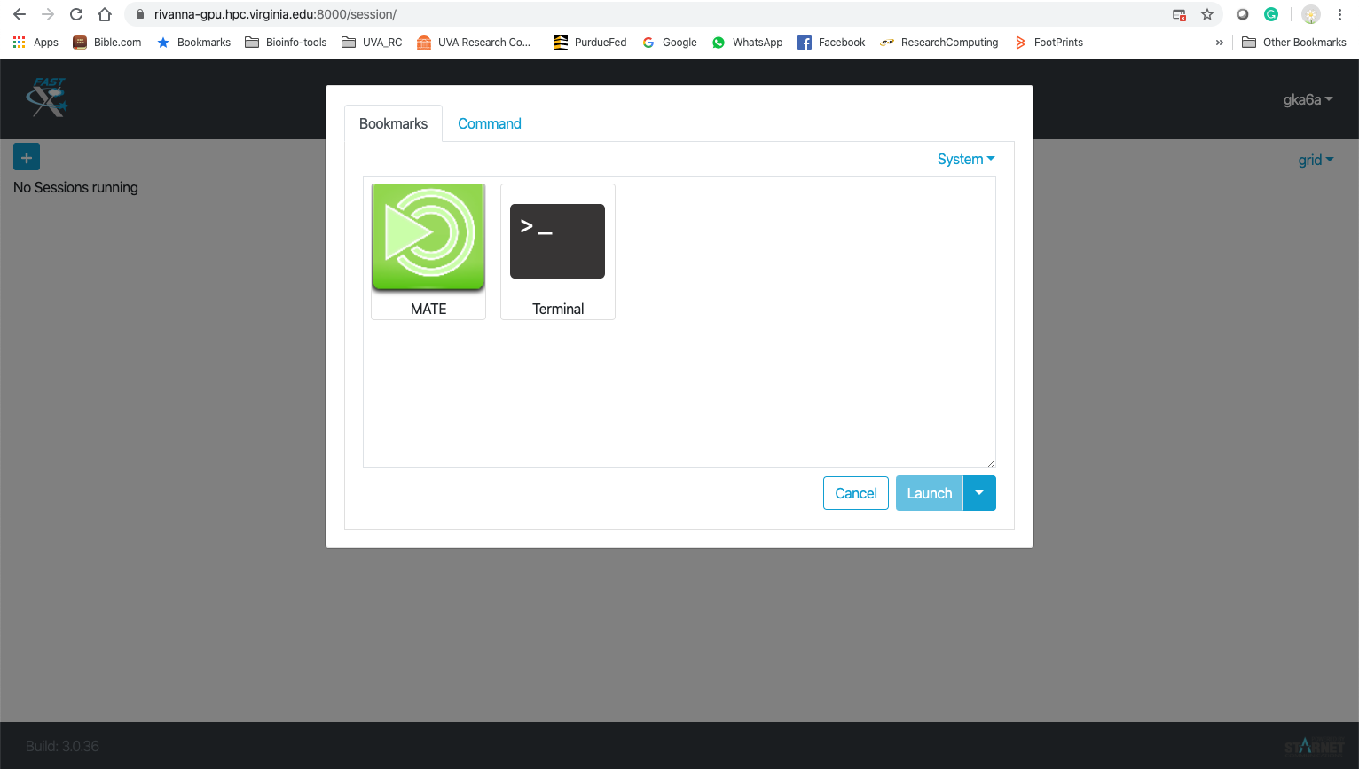
FastX web > + > Terminal > Launch

Slide 13
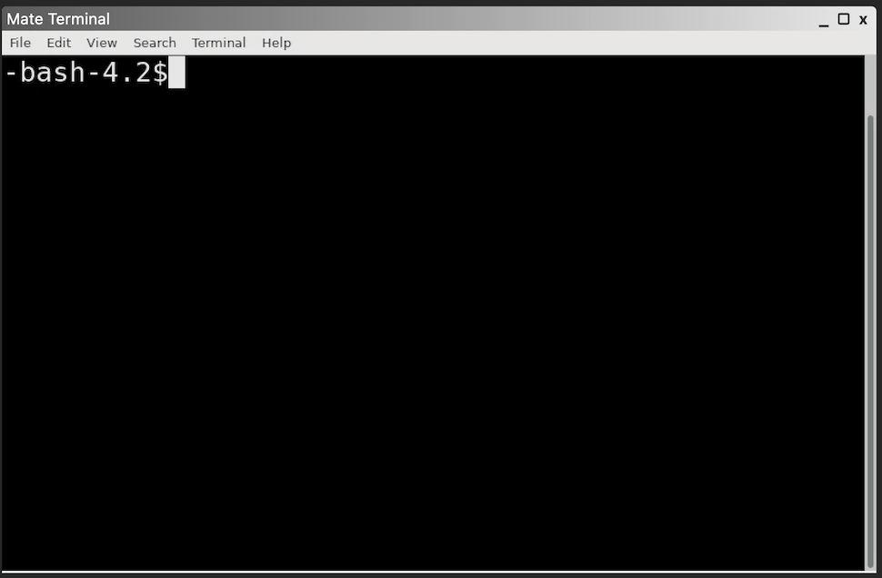
Terminal

Slide 14
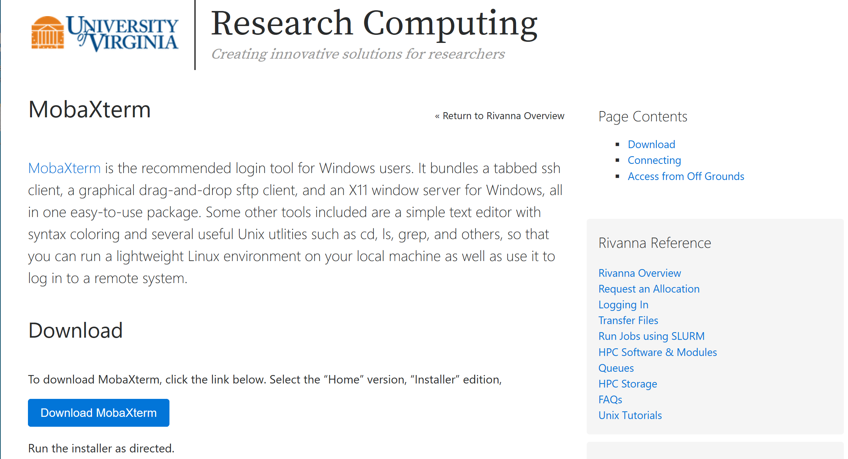
LOGGING IN (Win) – using MobaXterm
https://www.rc.virginia.edu/userinfo/rivanna/login/

Slide 15
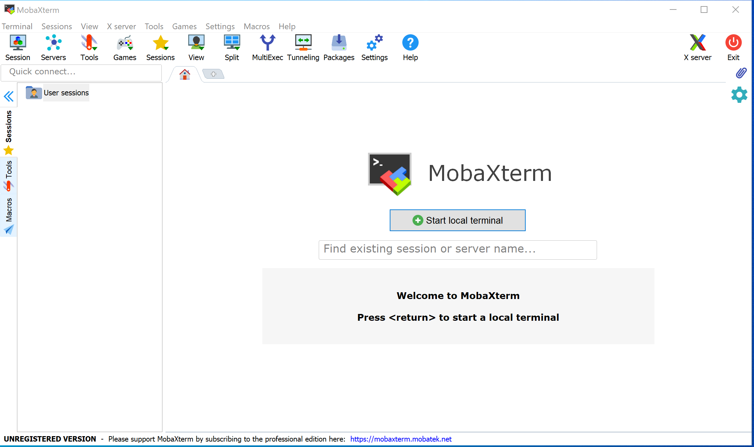

Slide 16
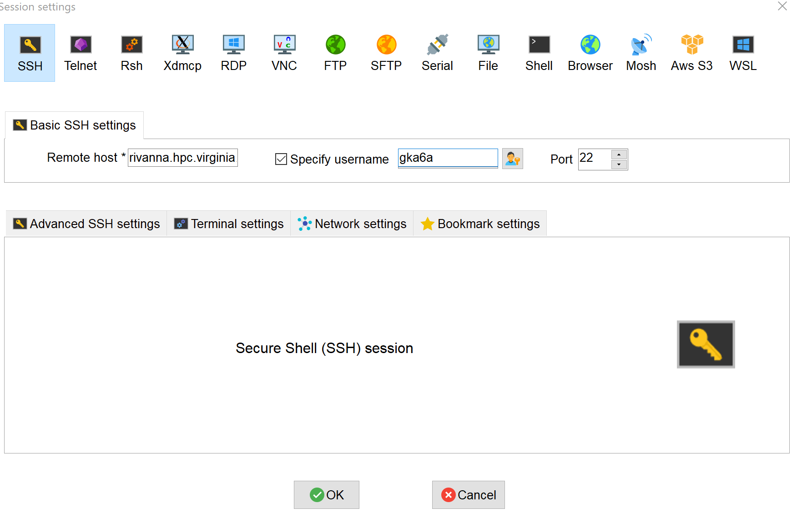
Remote host: rivanna.hpc.virginia.edu
UVA computing ID

Slide 17
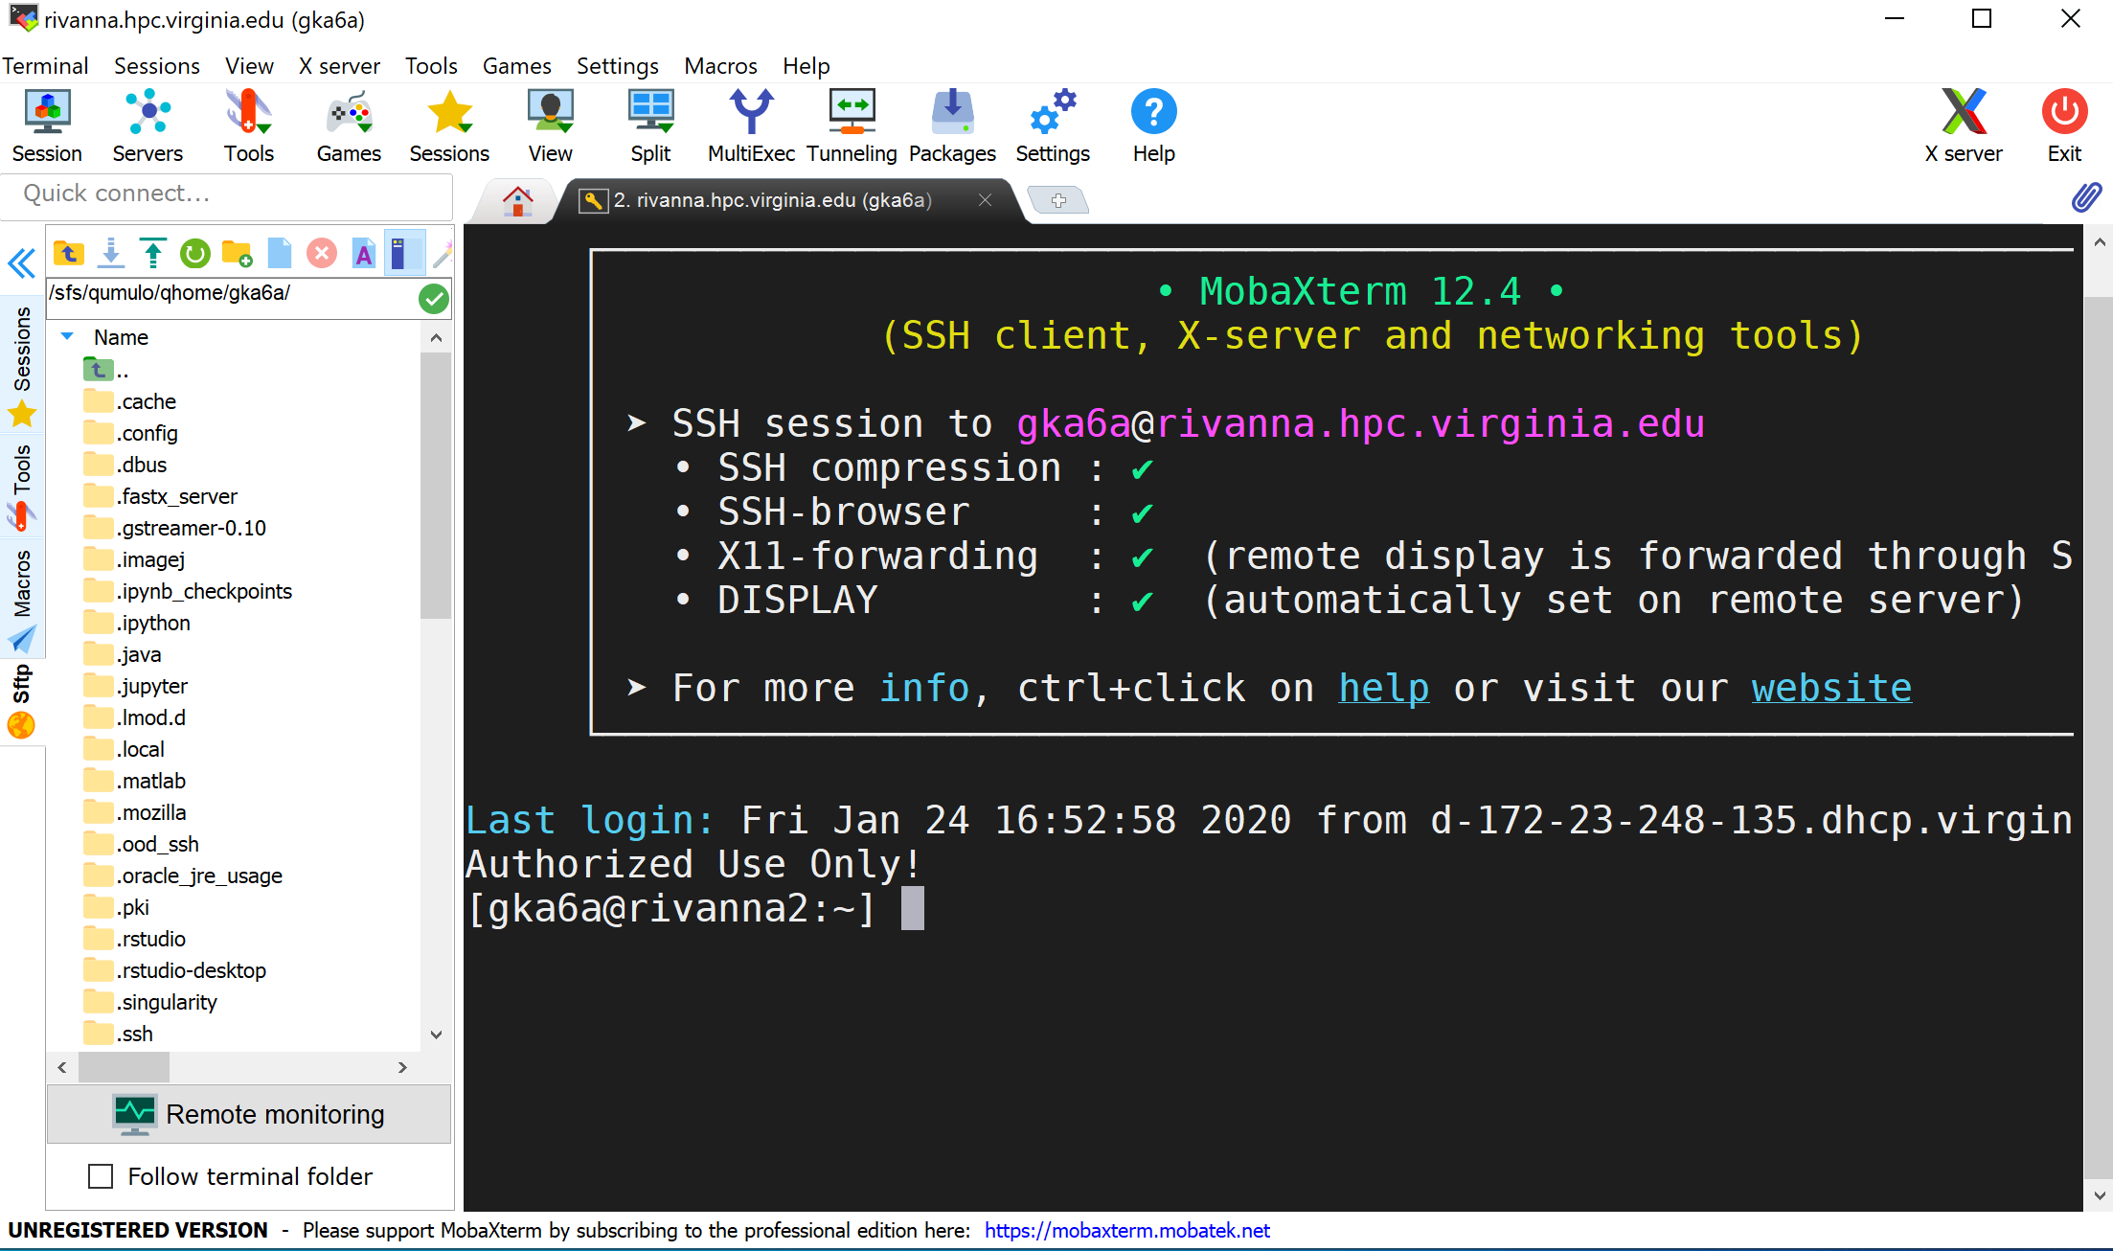

Slide 18
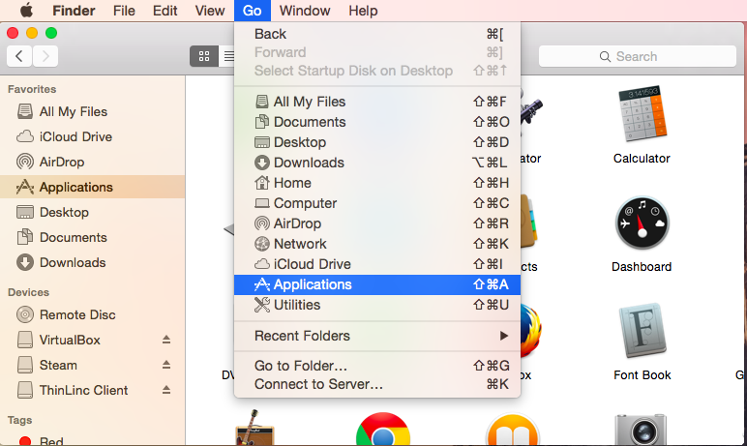
LOGGING IN – using a MAC
Mac OS X has built in Terminal app that can use SSH
Open Finder and Go to Applications

Slide 19
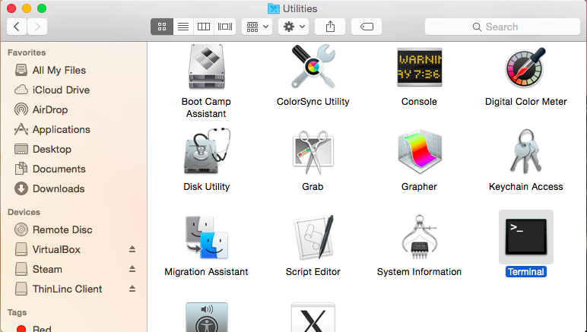
Utilities > Terminal app

Slide 20
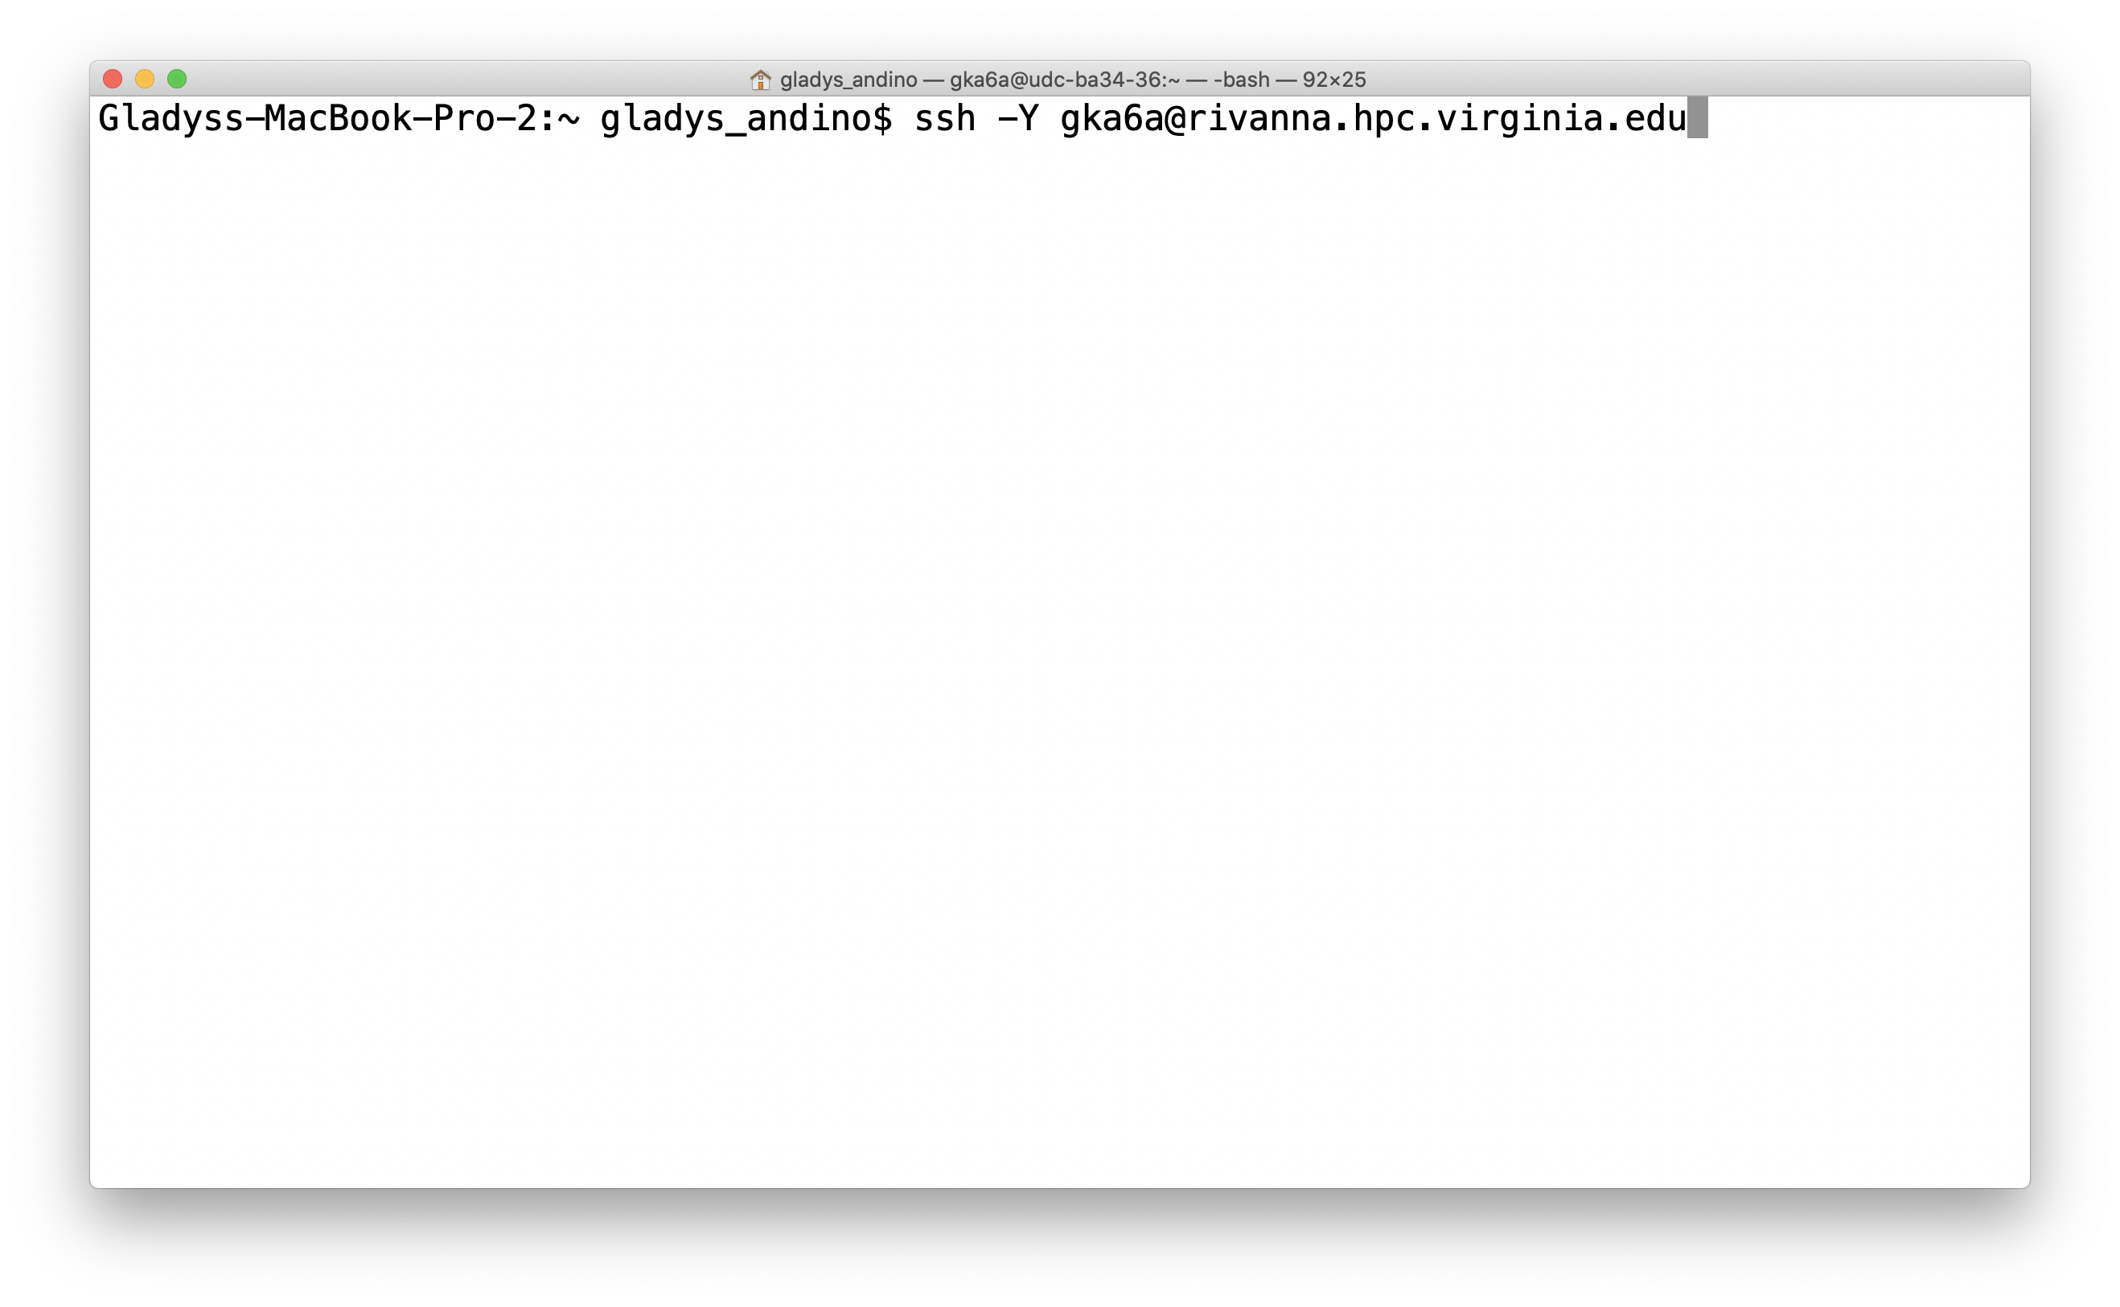
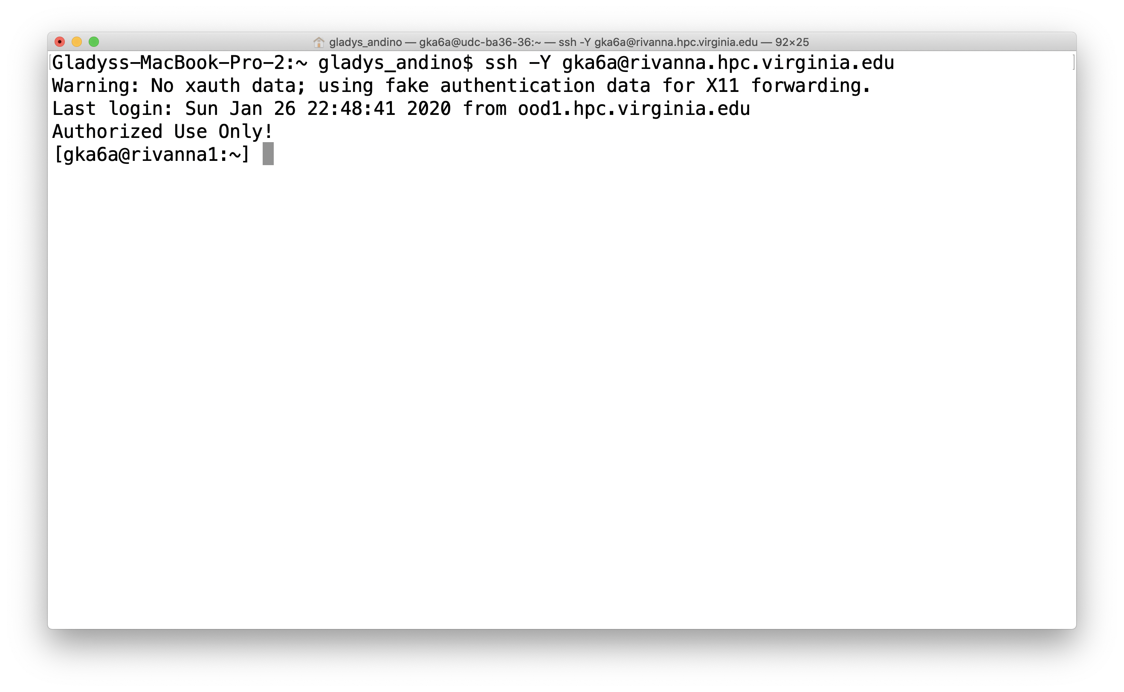
Connect using ssh –Y username@rivanna.hpc.virginia.edu

Slide 21
Unix Command-Line basics
Notes:
?

Slide 22

Dilbert, November 9, 1993

Slide 23
NAVIGATION SHELL
Let’s run our first command
$ pwd (print working directory)
command: prints working directory
/home/username # username should be your UVA computing ID
Know where you are!
$ pwd
/home/gka6a

Slide 24
FIRST LOOK – Let’s grab some files
$ cp -r /share/resources/tutorials/rivanna-cl ./
Spaces separate these parts!
Absolute path
Source
Relative path
Destination
Prompt
cmd
Arguments
Options/Flags

Slide 25
Bash History Mechanism
When using bash you may use its built-in history mechanism to save yourself some keystrokes.
Up arrow: scroll through the previous commands you have typed
Down arrow: if scrolled back, scroll to more recent commands
Left/right arrows: edit text on a line

Slide 26
More Bash Goodies
Tab completion
string<tab> causes bash to expand string further as far as it has a unique name.
Search for earlier command
control-r <text>
Move to the beginning of the line
control-a
Move to the end of the line
control-e
Clear the screen
clear or control-l

Slide 27

FILES AND DIRECTORIES
Files and directories are two important constructs in UNIX (and most operating systems)
Contain your documents, images, code, programs, OS, etc.
Everything in UNIX is built on files and directories (everything is a file)!
A “filesystem” is a collection of files and directories stored on a single physical device
Often called “drives” in Windows
/
bin
home
var
rs7wz
gka6a
jmh5ad
class-hpc
tutorials
data
Notes:
The Unix filesystem forms a tree structure that starts from the root, represented by / (forward slash). Files are organized into directories (folders).

Slide 28

FILES AND DIRECTORIES
Files store some sort of information
Two basic types of files:
Text (documents, code)
Binary (images, executables)
Unix doesn’t pay attention to file extensions, but software might
Directories are collections of files and directories
Analogous and interchangeable with “folders”
Both files and directories have “metadata” associated with them
Name, timestamps, permissions
.txt
.py
.slurm

Slide 29
Paths
/
In UNIX all files and directories have a “path”
The “path” is the fullname of every file & directory
At the top is the root directory that holds everything else. We refer to it using a slash character / on its own; this is the leading slash in /home/gka6a
Examples:
/ /home/gka6a /home/gka6a/rivanna-cl_013020 /home/gka6a/rivanna-cl_013020/basic_commands
bin
home
var
rs7wz
gka6a
jmh5ad
rivanna-cl_013020
tutorials
basic_commands

Slide 30
Paths
Example:
/home/gka6a/rivanna-cl # This is an absolute path.
The current directory can be represented by a period (.) Thus if we are in
/home/gka6a/rivanna-cl/basic_commands we can type
gedit ./hello_world.sh & # to edit or
./hello_world.sh # to execute the file
Notes:
or

Slide 31
Paths - Summary
Absolute paths
The path to a file starting at the root of the system
Begins with “/” to denote the path starts at the root
Guaranteed to get you there
Relative paths
The path to a file starting at the current location
Indicate current directory with “.”, parent directory as “..”
Can break if you start in the wrong place!
/home/gka6a/file.txt /home/gka6a/files/file.txt /home/gka6a/files/ /project/gka6a
file.txt ./file.txt files/file.txt ../gka6a/files/ ../../project/

Slide 32
LISTING FILES
ls command: list files in current directory
-l long listing, includes file date and size
-a displays all files.
-h show file sizes in human readable terms
-t show the newest files first
$ ls
basic_commands data protein redirects regex scripts Shakespeare
Notes:
ls –F

Slide 33
$ ls
basic_commands data protein scripts
$ ls -l
drwxr-xr-x 2 gka6a users 2560 Jan 29 13:20 basic_commands
drwxr-xr-x 2 gka6a users 2048 Jan 29 13:20 data
drwxr-xr-x 2 gka6a users 3584 Jan 29 13:20 protein
drwxr-xr-x 2 gka6a users 512 Jan 29 13:20 redirects
drwxr-xr-x 2 gka6a users 512 Jan 29 13:20 regex
drwxr-xr-x 3 gka6a users 5632 Jan 29 14:48 scripts
drwxr-xr-x 2 gka6a users 5120 Jan 29 13:20 shakespeare
$ ls -lah
drwxr-xr-x 9 gka6a users 4.0K Jan 29 15:20 .
drwx--s--x 42 gka6a users 29K Jan 29 14:32 ..
drwxr-xr-x 2 gka6a users 2.5K Jan 29 13:20 basic_commands
drwxr-xr-x 2 gka6a users 2.0K Jan 29 13:20 data
-rw-r--r-- 1 gka6a users 11K Jan 29 13:20 .DS_Store
drwxr-xr-x 2 gka6a users 3.5K Jan 29 13:20 protein
drwxr-xr-x 2 gka6a users 512 Jan 29 13:20 redirects
drwxr-xr-x 2 gka6a users 512 Jan 29 13:20 regex
drwxr-xr-x 3 gka6a users 5.5K Jan 29 14:48 scripts
drwxr-xr-x 2 gka6a users 5.0K Jan 29 13:20 shakespeare
$ ls -laht
drwxr-xr-x 9 gka6a users 4.0K Jan 29 15:20 .
drwxr-xr-x 3 gka6a users 5.5K Jan 29 14:48 scripts
drwx--s--x 42 gka6a users 29K Jan 29 14:32 ..
drwxr-xr-x 2 gka6a users 2.0K Jan 29 13:20 data
drwxr-xr-x 2 gka6a users 512 Jan 29 13:20 redirects
drwxr-xr-x 2 gka6a users 5.0K Jan 29 13:20 shakespeare
drwxr-xr-x 2 gka6a users 512 Jan 29 13:20 regex
drwxr-xr-x 2 gka6a users 3.5K Jan 29 13:20 protein
drwxr-xr-x 2 gka6a users 2.5K Jan 29 13:20 basic_commands
-rw-r--r-- 1 gka6a users 11K Jan 29 13:20 .DS_Store

Slide 34
CHANGING DIRECTORIES
cd (change directory) command: is used to jump from one directory to another.
Changes your present location to the parent directory.
cd ..
The directory which is up one level in the directory tree can be referred to as “..” dot dot.
cd with no directory name puts you into your home directory.
$ cd rivanna-cl/basic_commands
$ ls -lh
total 245M
-rw-r--r-- 1 gka6a users 2.1K Jan 29 13:20 intro_basic-unix.txt
-rwxr-xr-x 1 gka6a users 197M Jan 29 13:20 list_of_reads.txt
-rw-r--r-- 1 gka6a users 46M Jan 29 13:20 sequences.fasta
-rw-r--r-- 1 gka6a users 1.6M Jan 29 13:20 SP_R1.fastq
-rw-r--r-- 1 gka6a users 1.6M Jan 29 13:20 SP_R2.fastq
…

Slide 35
Summary - FILES AND DIRECTORIES
Directories = Folders
cd change directory
cd ~ move to home directory
cd .. move up one directory
Special directories
./ current directory
../ parent directory
~/ your home directory
Organize your work!

Slide 36
CREATING DIRECTORIES
mkdir command: (make directory)
$ cd rivanna-cl_013020/basic_commands
$ mkdir NEW_DIRECTORY
$ ls -lht
drwxr-xr-x 2 gka6a users 0 Jan 30 00:12 NEW_DIRECTORY
-rw-r--r-- 1 gka6a users 1.6M Jan 29 13:20 SP_R2.fastq
-rw-r--r-- 1 gka6a users 46M Jan 29 13:20 sequences.fasta
-rw-r--r-- 1 gka6a users 1.6M Jan 29 13:20 SP_R1.fastq
-rwxr-xr-x 1 gka6a users 197M Jan 29 13:20 list_of_reads.txt
-rw-r--r-- 1 gka6a users 2.1K Jan 29 13:20 intro_basic-unix.txt
Look NEW_DIRECTORY should be empty!!
Notes:
Note the dire

Slide 37
CREATING DIRECTORIES
You can use absolute paths or relative paths for the directory name.
Let’s work these examples!
mkdir newcode
mkdir /home/gka6a/newcode/build
cd newcode
mkdir ../oldcode
mkdir src
mkdir ../oldcode/src
Notes:
Work the example!

Slide 38
Exercise
Start a terminal
The example prompt is –bash$
Type after your prompt
echo $SHELL
pwd
mkdir test_dir
cd test_dir
ls ..
What is the full path of your home directory?

Slide 39
VIEWING CONTENTS OF A FILE
Most common ones are less, more, cat, head and tail.
less FILENAME
Displays file contents on the screen with line scrolling (to scroll you can use ‘arrow’ keys, ‘PgUp/PgDn’ keys, ‘space bar’ or ‘Enter’ key). When you are done press ‘q’ to exit.
In most implementations you can search in the forward direction with /<pattern>
$ pwd
/home/gka6a/rivanna-cl_013020/basic_commands
$ less intro_basic-unix.txt
Notes:
Less
i
Search

Slide 40
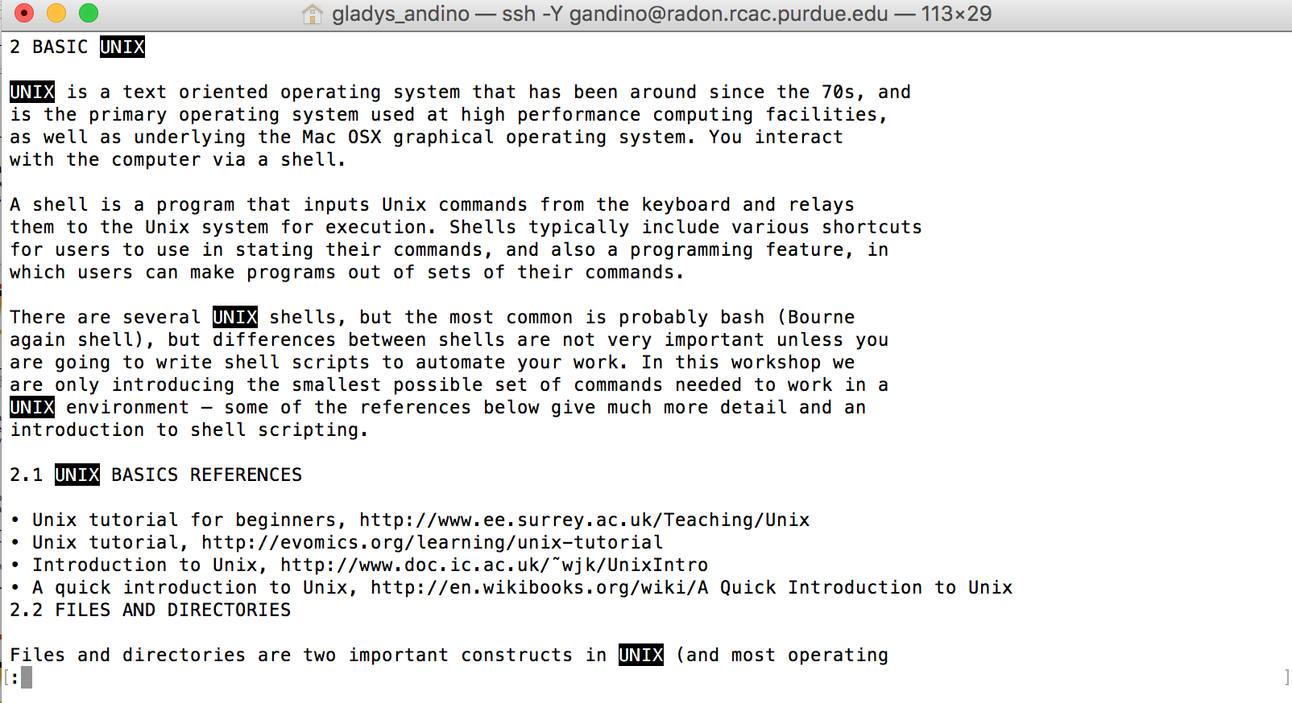
VIEWING CONTENTS OF A FILE
/<WORD_PATTERN>
/UNIX
SEARCHING FILE WHILE USING LESS
Notes:
For case insensitive: inside of less you can toggle the behavior you want by giving the -i command to less
Ignore case in searches (press RETURN)
Search word: /pattern

Slide 41
VIEWING CONTENTS OF A FILE
head FILENAME try this: head intro_basic-unix.txt
Displays only the starting lines of a file. The default is first ten lines. But any number of lines can be displayed using –n option (followed by required number of lines).
head intro_basic-unix.txt –n 5
tail FILENAME try this: tail intro_basic-unix.txt
Similar to head, but displays the last 10 lines. Again –n option can be used to change this.
More information about any of these commands can be found in ‘man’ pages (man command).

Slide 42
VIEWING CONTENTS OF A FILE
grep is one of the most commonly used commands in UNIX and it is commonly used to filter a file/input, line by line, against a pattern (e.g., to print each line of a file which contains a match for pattern).
General syntax:
grep [OPTIONS] PATTERN FILENAME
grep -i "Unix" intro_basic-unix.txt
A handy trick for bioinformaticians: how many sequences are in a FASTA-formatted file? By definition, each sequence record in a FASTA file has one line of description that always starts with > , followed by multiple lines of sequence itself. Each sequence record ends when the next line starting with > appears:

Slide 43
VIEWING CONTENTS OF A FILE
Let’s look at the fasta file first
$ pwd
/home/gka6a/rivanna-cl/basic_commands
$ grep -c '>' sequences.fasta
?
Please note to include the quotes around the “>”.
Notes:
31925

Slide 44
Copying Files
cp (copy) command: is used to copy a file. When using this command you have to provide both source file and destination file.
Source Destination
cp oldfile newfile
You can copy using relative paths
cp thisfile ../../place/else/thefile
Copy all files in a directory and its subdirectories:
cp –R thisdir thatdir
Do not overwrite an existing file (noclobber):
cp –n oldfile newfile
Ask before overwriting (-i and –n override each other):
cp –i oldfile newfile

Slide 45
MOVING A FILE OR DIRECTORY
mv can also be used to rename files and directories
mv OLDNAME NEWNAME
$ pwd
/home/gka6a/rivanna-cl/basic_commands
OLDNAME NEWNAME
$ mv SP_R1.list list_of_reads.txt
Notes:
Overwrite the file basic-unix.txt
Time stamp explanation
Overwrite the file basic-unix.txt

Slide 46
DELETING FILES AND DIRECTORIES
rmdir (remove directory) command: is used to delete directories from the system.
rmdir directory
The directory should be empty before you use the rmdir command
rm (remove) command: use to delete a file or a directory. Some useful options include:
-r recursively delete files
rm -r directory
Notes:
Remove this one

Slide 47
Exercise
If not already in your basic_commands navigate there. Type after your prompt bash$
cat > mynewfile
Ctrl + D to save it as a new empty file.
Use nano or editor of your preference and type a line or two of text.
more mynewfile
ls
mv mynewfile the_file
cp the_file old_file
ls -l

Slide 48
Your Best Friend
The basic documentation for a command can be read from the shell with the man (manual) command
man ls

Slide 49
Wildcards
Strings of characters may be replaced with wildcards.
The asterisk (*) can replace zero to unlimited characters (it does not replace a leading period).
The question mark (?) replaces exactly one character. Wildcards enable you to work with files without needing to type multiple files with similar names.
ls *py
rm list?.sh
BE CAREFUL when using wildcards with rm! Gone is gone! On some systems there may be backups, or maybe not, and on your personal system you would need to set up backups and learn to retrieve files.
Notes:
cd array_test ls input?.dat
ls input??.dat

Slide 50
Handy Commands
whoami
show my user ID
which <executable>
indicates the path to the executable specified
wc <file>
word count
wc –l <file> is lines only
date
Shows instantaneous date and time
exit
exit current shell (if login shell, this logs you off!)

Slide 51
Standard Streams
Each executable has associated with it, three I/O streams: standard input, standard error, and standard output.
Normally these streams come from or go to your console (i.e. your shell).
Most Unix commands read from standard input and/or write to standard output.
They are often represented as stdin, stderr, and stdout.

Slide 52
Stream Redirection
You can redirect standard input with <
mycode < params.txt
Redirect standard output with >
ls –l > filelist
Append with >>
cat file1 >> bigfile
Redirection of standard error depends on the shell
Bash:
make >& make.out
Redirects both stdout and stderr to make.out

Slide 53
Pipes
One of the most powerful properties of Unix is that you can pipe the standard output of one command into the standard input of another.
The pipe symbol | is above the backslash on most US keyboards.
Example
grep "@H-148:116" SP_R1.fastq | head
grep searches for the pattern in the file and head looks at the first 10 lines of the grep output

Slide 54
Running Executables
Executables are often called binaries, especially by Unix types and computer programmers. The terms are synonymous in most cases.
If the executable is in your search path you can simply type its name at the prompt.
gedit hello_world.slurm
here gedit is the name of the binary. Its actual location is /usr/bin/gedit, but /usr/bin is in the default search path.
If it is not in your search path you must type the path to the executable (can be absolute or relative)
./hello_world.slurm
Usually current directory is not in your default search path for security reasons.
Notes:
Fastx for X11,

Slide 55
Example
In most cases, current working directory (.) is not in your default search path. To add it, type (for bash)
export PATH=$PATH:.
In this case it is essential to add the first $PATH or you will lose the default path set by the system.

Slide 56
Process Control
Running from a command line:
Processes can be running in the foreground (no prompt returned to the shell) or background (prompt available). To start in the background add an ampersand (&) at the end of the command:
./myexec -o myopt myfile &
control-z (ctrl-z or ^z): suspend the job
bg place into background
fg forward a backgrounded job

Slide 57
Killing Processes
control-c (ctrl-c or ^c): kill the current running job (must be foregrounded).
Find the process ID with ps then:
kill -9 <pid>
terminates with extreme prejudice.
killall -9 <executable name>
same as above.
Notes:
Fastx

Slide 58
RIVANNA

Slide 59


Rivanna in More Detail
Compute Nodes
Head Nodes
ssh client
Ethernet
Home Directory
Other Storage
Scratch
(gpfs)
Infiniband

Slide 60
Your Home Directory
The default home directory on Rivanna has 50GB of storage capacity
The home directory is for personal use and is not shareable with other users.

Slide 61
Checking your Storage
To see how much disk space you have used in your home directory, open a Terminal window and type hdquota at the command-line prompt:
$hdquota
Type Location Name Size Used Avail Use%
=======================================================================
home /home gka6a 51G 12G 39G 24%
Project /project slurmtests 2.0P 1.9P 144T 93%
Project /project arcs 16T 12T 3.8T 75% Project /project rivanna_software 1.1T 4.2M 1.0T 1% Project /project ds5559 51G 3.7G 47G 8% Value /nv vol174 5.5T 1.2T 4.4T 21%
Notes:
Note: only home, and other storage just for some

Slide 62
Checking your Allocation
To see how many SUs you have available for running jobs, type at the command-line prompt: allocations
$ allocations
Allocations available to Gladys_Karina_Andino_Bautista (gka6a):
* arcs_admin: less than 500 service-units remaining
* ds5559: less than 25,000 service-units remaining
* ga_bioinfo-test: less than 100,000 service-units remaining
* hpc_build: less than 203,417 service-units remaining
* rivanna-training: less than 20,000 service-units remaining
for more information about a specific allocation, please run:
'allocations -a <allocation name>'
Notes:
allocation

Slide 63
Your /scratch Directory
Each user will have access to 10 TB of temporary storage.
It is located in a subdirectory under /scratch, and named with your userID
e.g., /scratch/gka6a
You are limited to 350,000 files in your scratch directory.
The /scratch directory is for personal use and is not shareable with other users.
Important:
/scratch is NOT permanent storage and files that have not been accessed for more than 90 days will be marked for deletion.

Slide 64
Running Jobs from Scratch
We recommend that you run your jobs out of your /scratch directory for two reasons:
/scratch is on a GPFS filesystem (a storage system designed specifically for parallel access).
/scratch is connected to the compute nodes with Infiniband (a very fast network connection).
We also recommend that
You keep copies of your programs and data in more permanent locations (e.g., your home directory or leased storage such as /project or /value).
After your jobs finish, you copy the results to more permanent storage).

Slide 65
The Modules Environment
Not strictly a part of Unix
Widely used by many HPC sites, including ours.
Enables the user to set complex paths, environment variables, and so forth, by loading a module (running a script).
The environment is set up automatically when you log in.
Modules loaded only affect the shell in which the command is run.
Modules required for a job must be loaded in the batch job script.

Slide 66
Modules Commands
module spider
List all available packages (may be a lot!)
module spider <package>
List all versions of <package>, if any
module spider <package>/<version>
Describes how to load <package>/<version>. There may be prerequisite modules.
module list
List modules loaded in current shell
module load <package>/[<version>]
Load the module for (optionally) <version> of <package>
module unload <package>
Delete the changes made by the <package> module
module purge
Remove all module modifications to the environment
module swap <package>/<current> <package>/<newver>
Exchange one version of a package for another

Slide 67

https://www.rc.virginia.edu/userinfo/rivanna/slurm/

Slide 68
Resource Managers
SLURM (Simple Linux Utility for Resource Management) is a resource manager (RM), also known as a queueing system.
Resource managers are used to submit jobs to compute nodes from an access point generally called a frontend.
Frontends are intended for editing, compiling, and very short test runs. Production jobs go to the compute nodes through the RM.

Slide 69
Resource Requests
A job (aka batch job) is described through a special form of shell script which contains directives to the RM to request resources.
Directives are pseudocomments that take a particular form. They are read by the RM to determine the resource requirement. The job is then placed into the queue.
Once a resource becomes available the job is started on a master compute node. The master runs the job script, treating the directives as comments.

Slide 70
SLURM Resource Requests
SLURM refers to queues as partitions. We do not have a default partition; each job must request one explicitly.
Queue Name | Purpose | Job Time Limit | Memory / Node | Cores / Node
standard | For jobs on a single compute node | 7 days | 256 GB 384 GB 768 GB | 28 40 40
gpu | For jobs that can use general purpose graphical processing units (GPGPUs) (K80, P100 and V100) | 3 days | 256 GB 384 GB 1 TB | 28 40 128
parallel | For large parallel jobs on up to 120 nodes (<= 2400 CPU cores) | 3 days | 384 GB | 40
largemem | For memory intensive jobs (<= 16 cores/node) | 4 days | 1 TB | 16
dev | To run jobs that are quick tests of code | 1 hour | 128 GB | 4

Slide 71
SLURM Resource Requests
Each master process corresponds to a task.
By default, each task is assigned to one core.
Resources are classified as
Core: often called "cpu" in directives but refers to each individual processing core
Node: a separate computing entity containing multiple CPU cores that can share the same memory.
Notes:
Add a picture of nodes vs cores

Slide 72
SLURM Resource Requests
1 NODE, 28 cores
Processor
Processor
Core
Core
Core
Core
Core
Core
Core
Core
Core
Core
Core
Core
Core
Core
Core
Core
Memory
Memory
Core
Core
Core
Core
Core
Core
Core
Core
Core
Core
Core
Core
Notes:
Add a picture of nodes vs cores

Slide 73
Example
#!/bin/bash
#SBATCH --nodes=1
#SBATCH --ntasks=1
#SBATCH --mem=32000 # mb total memory
#SBATCH –-time=1-12:00:00
#SBATCH --partition=standard
#SBATCH --account=rivanna-training
./myexec < input > output
Notes:
Note: memory per core vs total memory

Slide 74
What it Does
The lines beginning with #SBATCH request
1 node, 1 task, which by default uses a single core.
32GB of memory (measured in MB).
1 day and 12 hours of running time.
The standard partition (queue). A partition must be specified.
Account group rivanna-training
The job runs a serial executable myexec with input and output files redirected from standard input and standard output.
We would call this script whatever name we choose, say myjob.slurm

Slide 75
Submitting a Job
We use the sbatch command to submit the job:
sbatch myjob.slurm
The system returns a JOBID.
We do not make the script executable. The system handles that.
udc-ba36-25$sbatch myjob.slurm
Submitted batch job 36805
Notes:
./job.exec Do no use the front end
Can be used for debugging or checking syntax

Slide 76
Checking the Job
Once we submit it, we can monitor active jobs with
squeue
squeue -u gka6a # If I only want to see my jobs I can use
Job status:
PD pending
R running
CG exiting
$ squeue –u gka6a
JOBID PARTITION NAME USER ST TIME NODES NODELIST(REASON)
36805 standard myjob.sl gka6a R 1:45 1 udc-aw38-34-l

Slide 77
EXERCISE
Change directory to scripts and run the slurm file hello_world.slurm
What do you see when you run
squeue -u <yourID>
Notes:
./job.exec Do no use the front end
Can be used for debugging or checking syntax

Slide 78
Deleting a Job
If you need to cancel a job use scancel with the job ID (you must always know the job ID)
$ scancel 36805 #jobID

Slide 79
Common SLURM Directives
#SBATCH --nodes=<n>
#SBATCH --ntasks-per-node=<n>
#SBATCH --ntasks=<n>
#SBATCH --mem=<n> #in mb
#SBATCH --mem-per-cpu=<n> #in mb
#SBATCH --cpus-per-task=<n> #cores
#SBATCH --time=<d-hh:mm:ss>
#SBATCH --account=<mygroup>
#SBATCH --partition=<p>

Slide 80
Single-Letter Equivalents
Many SLURM directives have a single-letter equivalent which is used with a single hyphen and no equals symbol.
#SBATCH -N <n> #nodes
#SBATCH -n <n> #ntasks
#SBATCH -c <n> #cpus-per-task
#SBATCH -t <d-hh:mm:ss> #time
#SBATCH -A <mygroup> #account
#SBATCH -p <p>

Slide 81
Standard Streams
By default, SLURM redirects both standard output and standard error to slurm-<jobid>.out
Change the name of this file:
#SBATCH --output=<filename>
or
#SBATCH -o <filename>
Separate standard error
#SBATCH --error=<filename>
or
#SBATCH -e <filename>

Slide 82
Interactive Jobs
Most HPC sites, including UVa's, restrict the memory and time allowed to processes on the frontend.
The basic SLURM command to request interactive resources is salloc
However, it requires several options to work well so we have a local script
ijob
ijob takes the same arguments as the SLURM commmand salloc
ijob –c 1 –A myalloc -t <time> --mem <memory in MB> -p <partition> -J <jobname>

Slide 83

Need help?
https://www.rc.virginia.edu/support/#office-hours
https://www.rc.virginia.edu/support/

Slide 84


Slide 85
Advanced topics

Slide 86
Dotfiles – configuration files
“Dotfiles” are files that describe resources to programs that look for them.
They begin with a period or “dot” (hence the name).
Normally ls does not show them. ls -a shows them. Sometimes ls is aliased to ls –a.
Bash has two
.bash_profile
.bashrc
if no .bash_profile is present it will read .profile
.bash_profile is sourced only for login shell

Slide 87
Environment Variables
The search path is the set of directories that the operating system will search when you type the name of an executable. To see it, type
printenv PATH
PATH is an environment variable. Environment variables describe something about your working environment. Some of them you can set or modify; others are set by the system.
printenv
Prints all environment variables currently set.
export VAR
Allows variable to be passed to child shells
Bash only, sets and exports in one line
export VAR=value

Slide 88
Slurm Environment Variables
SLURM provides a number of environment variables that acquire values from the system.
Do not attempt to assign to any variable beginning with SLURM_
Directory from which job was submitted
SLURM_SUBMIT_DIR
Default is to cd to this directory before starting job
List of nodes
SLURM_JOB_NODELIST
Job ID
SLURM_JOB_ID
Number of task
SLURM_NTASKS
Task per node (if set in script)
SLURM_NTASKS_PER_NODE
Number of cores per task (if set in script)
SLURM_CPUS_PER_TASK

Slide 89
Job Arrays
A large number of similar jobs can be submitted through job arrays.
Must be a batch job.
Submit with --array=<range> option
sbatch --array=0-30 myjobs.sh
An increment can be provided
sbatch --array=1-7:2 myjobs.sh
This will number them 1, 3, 5, 7
Or provide a list
sbatch --array=1,3,4,5,7,9 myjobs.sh
Each job will be provided an environment variable
SLURM_ARRAY_JOB_ID
And each task will be assigned
SLURM_ARRAY_TASK_ID
based on the numbers in the specified range or list.

Slide 90
Array Script
Job arrays should be named (any job can be, job arrays should be named).
#SBATCH --job-name=<name>
or
#SBATCH -J <name>
All subjobs will use the same global resource requests.
A variable %A represents the overall SLURM_ARRAY_JOB_ID and %a represents SLURM_ARRAY_TASK_ID in the –o and –e directives.

Slide 91
File Specifications
It would be prudent to separate stdout and stderror
#SBATCH -o myjobs%A%a.out
#SBATCH -e myjobs%A%a.err
Prepare files with appropriate names, e.g.
myinput.0.in, myinput.1.in, …myinput.30.in
Invoke your program with a line such as
./myexec myinput.${SLURM_ARRAY_TASK_ID}.in

Slide 92
SLURM Job Arrays
Write a script to run the serial job.
Submit using
sbatch --array=<list indicator> myjob.slurm
The <list indicator> can be
A comma-separated list e.g. 1,2,3,4,5,6,13
A range, e.g. 1-6
A range with an increment, e.g. 1-10:2
Indicators cannot be mixed
An environment variable
SLURM_ARRAY_JOB_ID
corresponds to the job ID.
An environment variable
SLURM_ARRAY_TASK_ID
will be set for each number, based on the numbers in the specified range or list.

Slide 93
Example Script
#SBATCH -N 1
#SBATCH -n 1
#SBATCH -t 04:00:00
#SBATCH -J montecarlo
#SBATCH -A rivanna-training
#SBATCH –p standard
#SBATCH -o output%A.%a
#SBATCH -e error%A.%a
./mccode < input${SLURM_ARRAY_TASK_ID}.dat

Slide 94
EXERCISE
Make an appropriate directory for your project.
Copy mccode from /share/resources/tutorials/hpc to your new directory.
Copy generate.py from the same place into the same new directory and run
module load anaconda/5.2.0-py3.6
python generate.py
It will produce 20 files (you can change this if you know how).
Type in the example SLURM script and submit it.

